Slide 1
The IBM Cell Architecture
Sam Sandbote
CSE 8383 Advanced Computer Architecture
April 18, 2006

Slide 2
Topics
Overview
Software Cells
Machine Architecture
Product Prototype
Programmer’s Interface
References and Glossary

Slide 3
Topics
Overview
Software Cells
Machine Architecture
Product Prototype
Programmer’s Interface
References and Glossary

Slide 4
Motivation
IBM’s formal name for Cell is “Cell Broadband Engine Architecture” (CBEA)
Sony wanted:
  Quantum leap in performance over PlayStation 2’s “Emotion Engine” chip (made by Toshiba)
Toshiba wanted:
  Remain a part of volume manufacturing for Sony PlayStation
IBM wanted:
  A piece of the PlayStation 3 pie
  A second try at network processor architecture
  Something reusable, applicable far beyond PlayStation

Slide 5
Goals
Application domains
  Graphics Rendering ($$)
  DSP & Multimedia Processing ($$)
  Cryptography
  Physics simulations
  Matrix math and other scientific processing
Heavy use of SIMD – why?
  Cray and similar machines of 1970s achieved performance through vectorization rather than MIMD parallelization
  The above applications are areas in which SIMD is still the best architecture

Slide 6
Topics
Overview
Software Cells
Machine Architecture
Product Prototype
Programmer’s Interface
References and Glossary

Slide 7
Software Cells: The Concept
Definition
  Bundle of application code and working data
Features
  Necessarily object-oriented
  Cells can migrate to any processor – local or remote
  Distributed processing is native, and actually assumed
    Execution of cell code actually looks like a remote procedure call
  A cell contains everything it needs to execute autonomously without references to other memory, programs or resources
  Highly secure model!

Slide 8
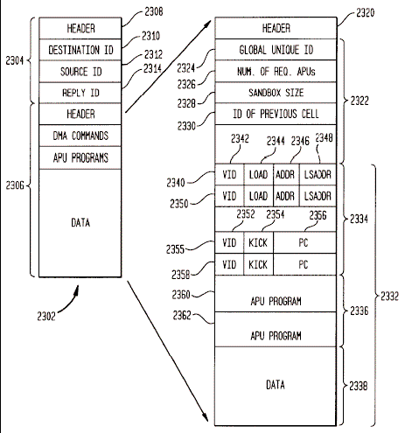
Software Cells: Formatting
Source:
U.S. Patent
#6,809,734

Slide 9
Comparison with Dataflow Architecture
Granularity
  Dataflow execution granularity is one instruction
  Cell execution granularity is a procedure, or several hundred instructions
Dataflow instruction template:
opcode
operand A
address
operand B
address
destination
address

Slide 10
Topics
Overview
Software Cells
Machine Architecture
Product Prototype
Programmer’s Interface
References and Glossary

Slide 11
Machine Architecture
Each Cell SoC contains:
  Conventional processor (PPE), for control and a lightweight OS
    2-way SMT, 2-way superscalar in-order Power core
  Multiple Synergistic Processing Elements (SPEs)
    These are execution engines for RPC of a software-cell
  DMA interface to memory and I/O
  Element Interconnect Bus (EIB), actually a ring bus
Each SPE contains:
  128 registers, 128 bits wide in unified regfile (2Kbytes of registers!)
  256 Kbytes local memory
  4 SIMD integer pipelines/ALUs
  4 SIMD floating point pipelines/FPUs

Slide 12
SoC Architecture
256KB
local
memory
256KB
local
memory
FPUs (4)
regfile
128x128
DMA, I/O
Controllers
regfile
128x128
FPUs (4)
ALUs (4)
ALUs (4)
EIB
256KB
local
memory
256KB
local
memory
FPUs (4)
regfile
128x128
regfile
128x128
FPUs (4)
ALUs (4)
512K L2
ALUs (4)
256KB
local
memory
256KB
local
memory
FPUs (4)
regfile
128x128
I$
D$
regfile
128x128
FPUs (4)
ALUs (4)
64-bit SMT
Power core,
2x in-order
superscalar
ALUs (4)
256KB
local
memory
256KB
local
memory
FPUs (4)
regfile
128x128
regfile
128x128
FPUs (4)
ALUs (4)
ALUs (4)
PPE

Slide 13
(Envisioned) SPU Architecture
Resources for execution of multiple software cells are reserved in advance by the PPE:
  Some portion of local memory
  One or more dedicated integer/FP pipelines
  Not SMT – pipelines are allocated in a dedicated way for the duration of the execution of the cell
Execution is supposed to be entirely self-contained
  Software cell is small enough to execute on only one APU
  No use of DRAM – the only addressable memory is local
    Local memory is not cache – no coherence
  No interaction with any other executing cell until finished

Slide 14
Topics
Overview
Software Cells
Machine Architecture
Product Prototype
Programmer’s Interface
References and Glossary

Slide 15
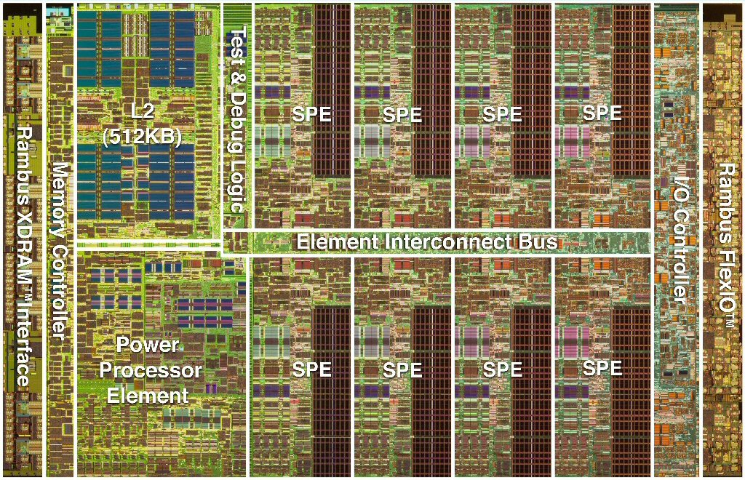
Prototype Chip Floorplan
Source: IBM

Slide 16
Notes on Prototype
Chip Statistics
  Peak single precision > 256 Gflops
  Peak double precision > 26 Gflops
  4.6GHz frequency demonstrated in working silicon
    This was historic, following Intel 6GHz Tejas project cancellation
    11 gates per cycle – more than is typical
  Rambus XDR DRAM interface, 25.6GB/s
  234M transistors, 221mm² in 90nm SOI process
  Power is 80W @ 1.2V typical (estimated)
  2,965 chip pins
SPE Disappointments
  Does not support execution of multiple cells at once
  Probably a lot of wasted execution units

Slide 17
Topics
Overview
Software Cells
Machine Architecture
Product Prototype
Programmer’s Interface
References and Glossary

Slide 18
Programmer’s Interface: Two-Parts
Control and Management on PPE
  Ordinary Power ISA and programmer’s view
  Runs a lightweight Linux OS – main tasks are:
    Coordinate execution of software cells
    Route data inputs and outputs
    Handle run-time exceptions
Software Cell Execution on SPE
  New ISA and new (extremely simple) programmer’s view
  Requires special code development tools
    Possibly, a special programming language
    Special compiler
    Debugging of distributed processing is messy

Slide 19
Topics
Overview
Software Cells
Machine Architecture
Product Prototype
Programmer’s Interface
References and Glossary

Slide 20
Cell References
Flachs et al. “The Microarchitecture of the Streaming Processor for a CELL Processor.” Proc. 2005 ISSCC.
Gaudiot and Bic (editors). Advanced Topics in Data-Flow Computing. Prentice Hall, 1991.
Gschwind et al. “A novel SIMD architecture for the Cell heterogeneous chip-multiprocessor.” HotChips 17, August 2005.
Halfhill, Tom. “New Patent Reveals Cell Secrets.” Microprocessor Report, 1/3/05-01.
Krewell, Kevin. “Cell Moves Into the Limelight.” Microprocessor Report, 2/14/05-01.
Pham et al. “The Design and Implementation of a First-Generation CELL Processor.” Proc. 2005 ISSCC.
Suzuoki et al. “Resource Dedication System and Method for a Computer Architecture for Broadband Networks.” U.S. Patent No. 6,809,734.

